Slide 1

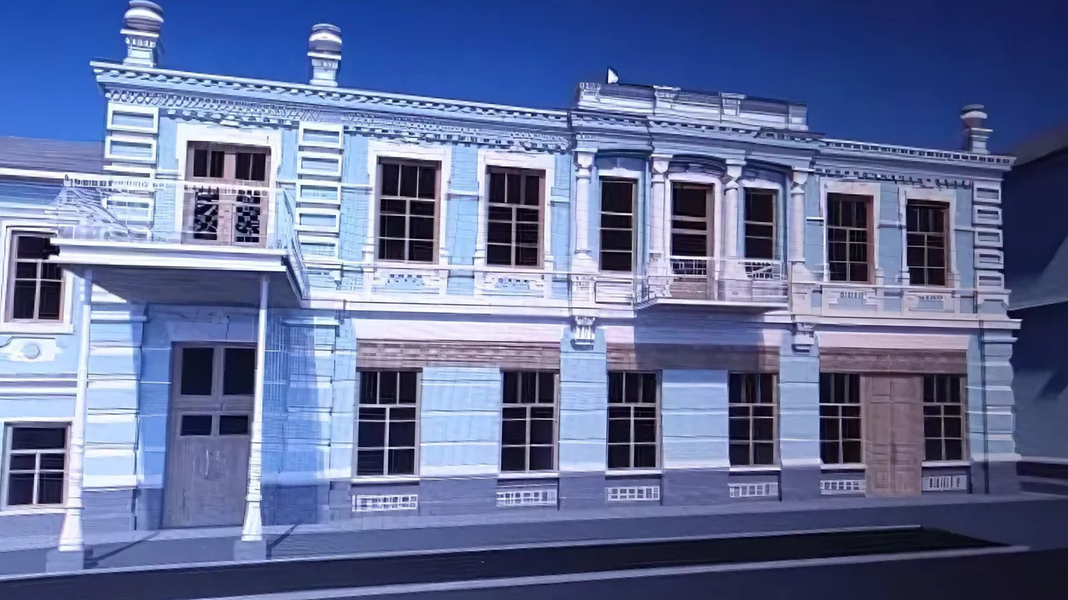












Restoration project of the historical building (part) of the Cherkasy Children's Music School No. 1 named after M.V. Lysenko
The project includes the following works:
Currently, the number of visitors of the institution:
restoration of the facade
restoration of destroyed parts of the building
repair of the fire safety system and the surrounding area
modern equipment, restoration of the territory
660 students
110 employees
The number of visitors is 450 people per day
The total cost of the project is
≈ 370 000 EUR

Slide 2

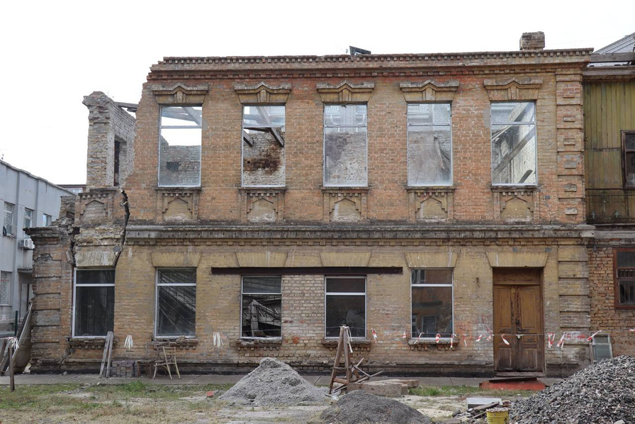


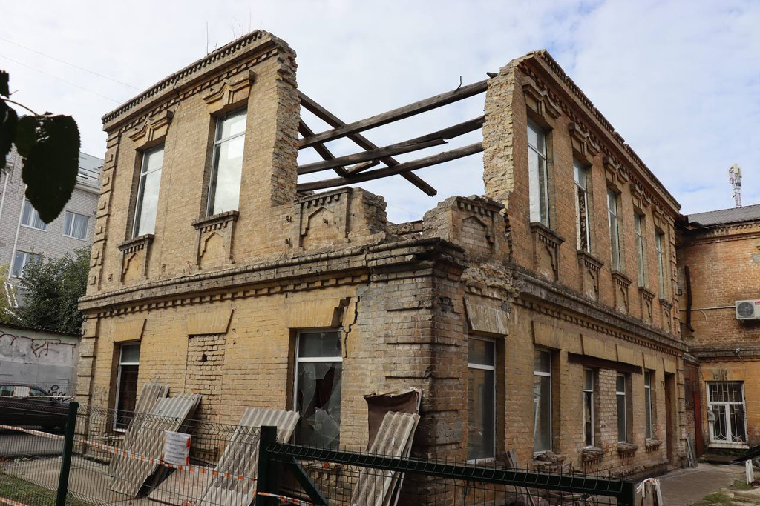

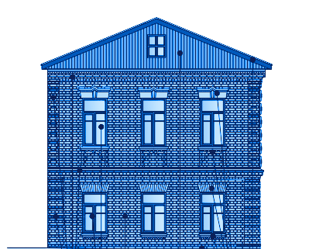
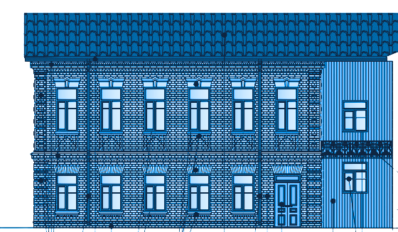
The building of the music school is included in the State Register of Immovable Monuments of Ukraine as an architectural monument of local significance
After the restoration, 6 additional classrooms, a new choir hall with a capacity of 70 people for concert choirs and symphony orchestra rehearsals will appear in the school
In order to expand the range of educational services in the future, the school will have the opportunity to expand other artistic specializations

